Slide 1
Hosted Git
github

Slide 2
Why Version Control?
For working by yourself:
  Gives you a “time machine” for going back to earlier versions
  Gives you great support for different versions (standalone, web app, etc.) of the same basic project
For working with others:
  Greatly simplifies concurrent work, merging changes
For getting an internship or job:
  Any company with a clue uses some kind of version control
  Companies without a clue are bad places to work

Slide 3
GitHub VS Git
GitHub = Remote (web).
Git = Local (on you computer),

Slide 4

GitHub
Largest open source git hosting site
Public and private options
  CS collaboration policy: your homework must be stored in a private repository.
  https://education.github.com/
User-centric rather than project-centric
Try it
  Log onto github
  Walk through the tutorials

Slide 5
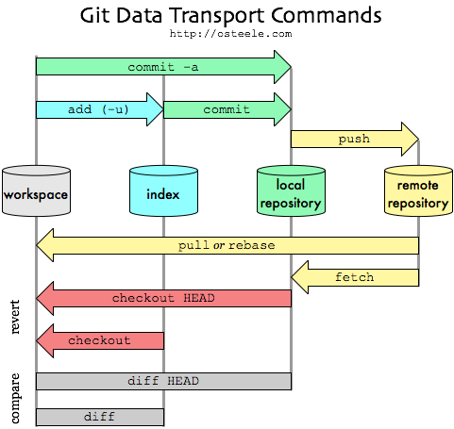
The Big Picture
Now we’ll talk about this part
http://blog.mikepearce.net/2010/05/18/the-difference-between-git-pull-git-fetch-and-git-clone-and-git-rebase/

Slide 6
What is repository
Repository
  The repository is where files' current and historical data
  are stored, often on a server. Sometimes also called a depot.

Slide 7
What is clone
Cloning means creating a repository containing the revisions from another repository. This is equivalent to pushing or pulling into an empty (newly initialized) repository

Slide 8
What is commit
To commit (check in, submit or record) is to write or merge the changes made in the working copy back to the repository. The terms 'commit' and 'checkin' can also be used as nouns to describe the new revision that is created as a result of committing.

Slide 9
Pull and push
Copy revisions from one repository into another.
Pull is initiated by the receiving repository, while
push is initiated by the source.
Fetch is sometimes used as a synonym forpull

Slide 10
What is merge
A merge or integration is an operation in which two sets of changes are applied to a file or set of files

Slide 11
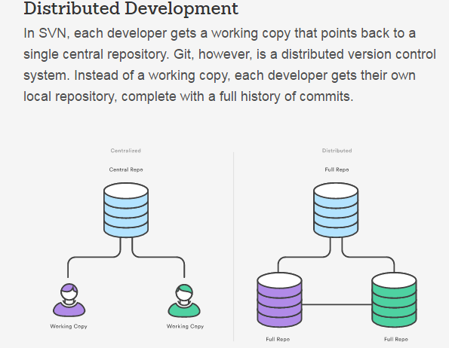

Slide 12
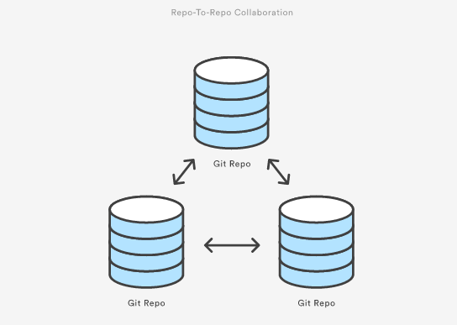

Slide 13

How do I use github?
Set up a user account
  public account is free, students can request 5 private
  Remember your password!
Create a repository
  Add github as a “remote”
Push your master branch (later we’ll deal with other branches, just work with master for now)
Add collaborators (if public, everyone can read, but not write. If private, must be collaborator to even read)
http://git-scm.com/book/en/v2/Git-Basics-Working-with-Remotes

Slide 14
Typical workflow
Person A
Setup project & repo
push code onto github
edit/commit
edit/commit
pull/push
Person B
clone code from github
edit/commit/push
edit…
edit… commit
pull/push
This is just the flow, specific commands on following slides.
It’s also possible to create your project first on github, then clone (i.e., no git init)

Slide 15
Smart http
Use it on the client:
  git clone https://github.com/CyndiRader/JavaDemos.git
protocol
userID
repository
When you create a repo on github, it will show you the HTTPS clone URL
Avoid typos: a) copy the URL, b) in git bash, click git-icon/edit/paste OR press Insert.

Slide 16
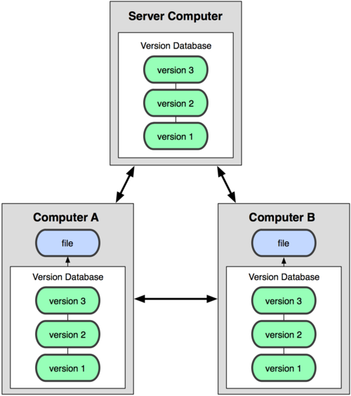
Collaborating via github - cloning
git clone adds the remote repository under the name origin
git clone https://github.com:[user name]/[repository name].git
  git clone https://github.com:CyndiRader/JavaDemos.git

Slide 17
Configure user information for all local repositories
$ git config --global user.name "[name]“
Ex: git config --global user.name “kumar Talakola”
Sets the name you want attached to your commit transactions
$ git config --global user.email "[email address]“
Ex: git config --global user.email “email adress”
Sets the email you want attached to your commit transactions
$ git config --global color.ui auto
Enables helpful colorization of command line output

Slide 18
Git SSL Certificate Problem Caused By Self Signed
Turn off Git SSL Verification
git config --global http.sslVerify false
Tell Git Where Your Certificate Authority Certificates Are
git config --system http.sslCAPath /git/certificates
Tip: Open git in firefox to resolve and import certificate issues

Slide 19
Create master repo – On GitHub
Log onto github
Click on + to add repository
Enter name
Add .gitignore, good to have a README
Click on Settings to control access (Collaborators tab)
On PC, do git clone
DEMO--

Slide 20
How to ignore files- github
Select .ignore .extend files like c, c++, java

Slide 21
Create Master repo
DEMO

Slide 22
Create a Branch- Git hub
Branching is the way to work on different versions of a repository at one time.
A branch is a parallel version of a repository.
By default your repository has one branch named master which is considered to be the definitive branch.
We use branches to experiment and make edits before committing them to master.
When you create a branch off the master branch, you’re making a copy, or snapshot, of master as it was at that point in time.
If someone else made changes to the master branch while you were working on your branch, you could pull in those updates.

Slide 23
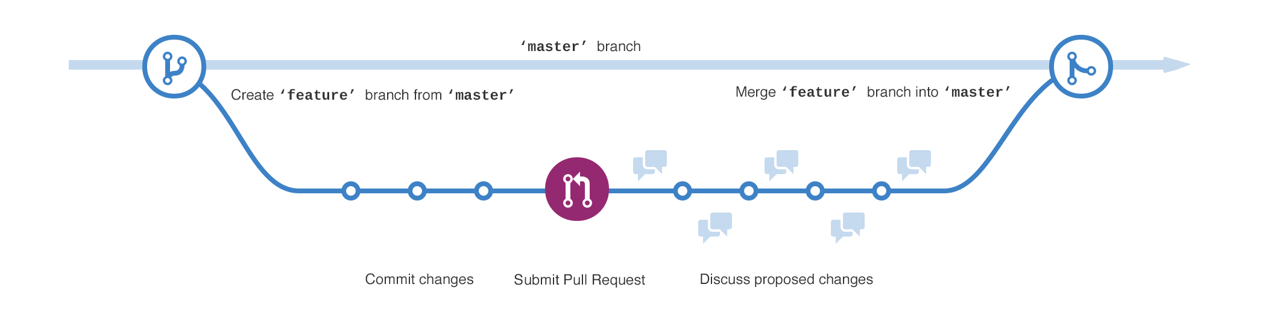
Branch- Continue

Slide 24
More Branch
The master branch
A new branch called feature (because we’re doing ‘feature work’ on this branch)
The journey that feature takes before it’s merged into master

Slide 25
Create New branch
Go to your new repository hello-world.
Click the drop down at the top of the file list that says branch: master.
Type a branch name, readme-edits, into the new branch text box.
Select the blue Create branch box or hit “Enter” on your keyboard.

Slide 26
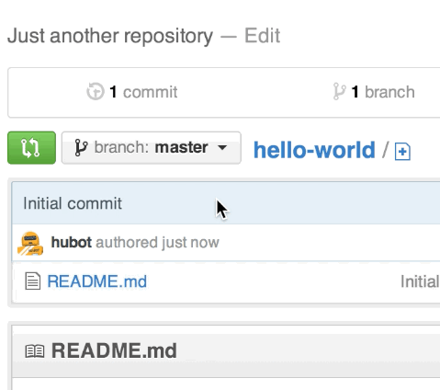
How to create branch -GitHub?

Slide 27
Create Branch- local git
Create a branch on local git
Ex: git branch mybranch
Switch to branch
Ex: git checkout my branch
Create branch and switch
git checkout –b mybranch
Merge Branch to Master
git checkout master
git merge mybranch

Slide 28
Create Local Repositories -GIT
Start a new repository or obtain one from an existing URL
$ git init [project-name]
Creates a new local repository with the specified name from master
git add <File Name>
Git commit –m <file name>
$ git clone [url] from master
Ex: git clone https://git@github.com/username/myproject.git
Downloads a project and its entire version history
$ git clone [url] from branch
git clone -b my-branch https://git@github.com/username/myproject.git

Slide 29
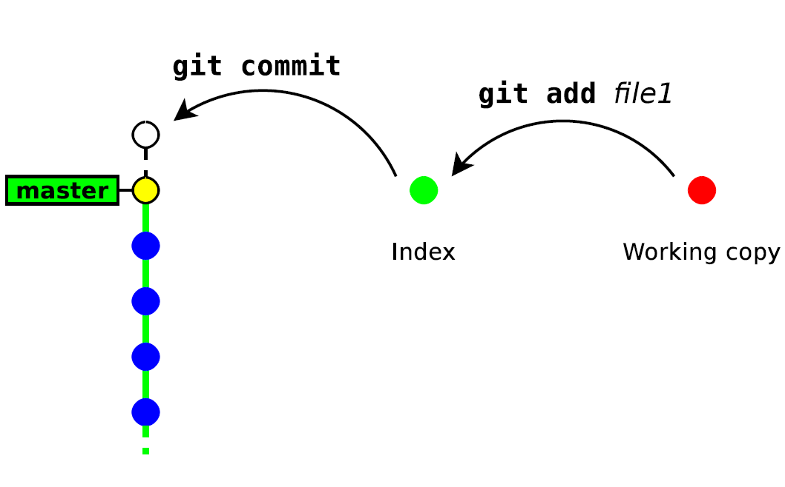
More Git add & Commit

Slide 30
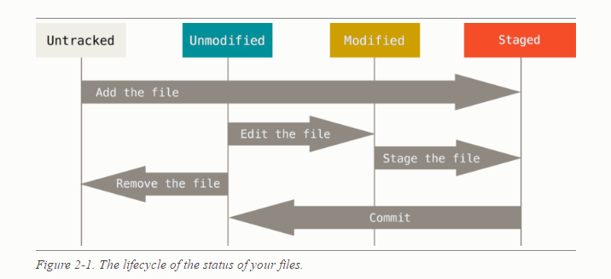
Recording Changes to the Repository

Slide 31
MAKE CHANGES
Review edits and craft a commit transaction
$ git status
Lists all new or modified files to be committed
$ git add [file]
Snapshots the file in preparation for versioning
$ git reset [file]
Unstages the file, but preserve its contents
$ git commit -m "[descriptive message]"
Records file snapshots permanently in version history

Slide 32
.gitignore file --git
Go to local repo and create .gitignorefile using notepad
And add files to ignore
*.txt
*.png

Slide 33
SYNCHRONIZE CHANGES
Register a repository bookmark and exchange version history
$ git fetch [bookmark]
Downloads all history from the repository bookmark
$ git merge [bookmark]/[branch]
Combines bookmark’s branch into current local branch
$ git push [alias] [branch]
Uploads all local branch commits to GitHub
$ git pull
Downloads bookmark history and incorporates changes

Slide 34
REVIEW HISTORY
Browse and inspect the evolution of project files
$ git log
Lists version history for the current branch
$ git log --follow [file]
Lists version history
$ git diff [first-branch]...[second-branch]
Shows content differences between two branches for a file, including renames
$ git show [commit]
Outputs metadata and content changes of the specified commit

Slide 35
REDO COMMITS
Erase mistakes and craft replacement history
$ git reset [commit]
Undoes all commits after [commit], preserving changes locally
$ git reset --hard [commit]
Discards all history and changes back to the specified commit

Slide 36
Create remote and local repo – workflow
Create your Java Project
Create your local repo
  git init
  git commit –m “Initial commit”
Create a repo on github
Add a “shortname” for your git repository
  git remote add [shortname] [url]
  git remote add origin https://github.com:[user name]/[repository name].git
  Ex: git remote add origin https://github.com:CyndiRader/JavaDemos.git
  Remember: You can copy/paste the repo url from github
Push your code onto github
  git push –u [remote-name] [branch-name].
  Ex: git push –u origin master – enter username/password

Slide 37
Keep everyone in synch
Be very careful not to make conflicting changes!
Merge with conflicts covered later
Two options for synchronizing:
  Fetch/merge
  Pull
Pull is usually simpler, but we’ll cover both.

Slide 38
Reference
Under standing Git hub flow:
https://guides.github.com/introduction/flow/

Slide 39
Example- demo– Next Training session
Initialize the local repo (git init)
Write you code and document, etc.
Add changes to index (e.g., git add . )
Commit the changes (git commit -m "some message")
git remote add upstream <your_repo_url>
git push upstream master
git push -f upstream master
git clone <your_remote_repo>
git push origin master
$ git remote add origin <REMOTE_URL>
# Sets the new remote
$ git remote -v
# Verifies the new remote URL

